Slide 1
UNIT-V
EMBEDDED PROGRAMMING CONCEPTS

Slide 2
Introduction
Embedded C is one of the most popular and commonly used Programming Languages in the development of Embedded Systems.
Embedded C is perhaps the most popular languages among Embedded Programmers for programming Embedded Systems.
There are many popular programming languages like Assembly, BASIC, C++ etc. that are often used for developing Embedded Systems but Embedded C remains popular due to its efficiency, less development time and portability.

Slide 3
Factors for Selecting the Programming Language
The following are few factors that are to be considered while selecting the Programming Language for the development of Embedded Systems.
Size: The memory that the program occupies is very important as Embedded Processors like Microcontrollers have a very limited amount of ROM.
Speed: The programs must be very fast i.e. they must run as fast as possible. The hardware should not be slowed down due to a slow running software.
Portability: The same program can be compiled for different processors.
Ease of Implementation
Ease of Maintenance

Slide 4
Earlier Embedded Systems were developed mainly using Assembly Language.
Even though Assembly Language is closest to the actual machine code instructions, the lack of portability and high amount of resources spent on developing the code, made the Assembly Language difficult to work .
There are other high-level programming languages that offered the above mentioned features but none were close to C Programming Language.

Slide 5
Introduction to Embedded C Programming
Embedded C Programming Language is widely used in the development of Embedded Systems.
The Embedded C Programming Language uses the same syntax and semantics of the C Programming Language like main function, declaration of datatypes, defining variables, loops, functions, statements, etc.

Slide 6
Difference between C and Embedded C
There is actually not much difference between C and Embedded C apart from few extensions and the operating environment.
Both C and Embedded C are ISO Standards that have almost same syntax, datatypes, functions, etc.
Embedded C is basically an extension to the Standard C Programming Language with additional features like Addressing I/O, multiple memory addressing and fixed-point arithmetic, etc.
C Programming Language is generally used for developing desktop applications whereas Embedded C is used in the development of Microcontroller based applications.

Slide 7
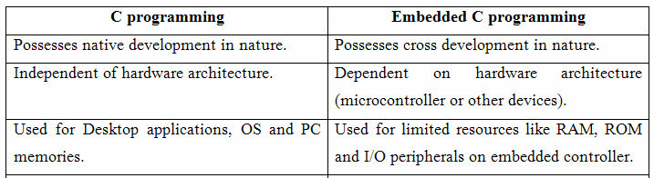

Slide 8
Advantages of embedded C program
Its takes less time to develop application program.
It reduces complexity of the program.
It is easy to verify and understand.
It is portable in nature from one controller to another.

Slide 9
Data Types in Embedded C
Data Types in C Programming Language help us declaring variables in the program.
There are many data types in C Programming Language like signed int, unsigned int, signed char, unsigned char, float, double, etc.
In addition to these there few more data types in Embedded C.
The following are the extra data types in Embedded C associated with the Keil’s Cx51 Compiler.
bit
sbit
sfr
Sfr16 etc…..

Slide 10
The following table shows some of the data types in Cx51 Compiler along with their ranges.
Data Type | Bits (Bytes) | Range
bit | 1 | 0 or 1 (bit addressable part of RAM)
signed int | 16 (2) | -32768 to +32767
unsigned int | 16 (2) | 0 to 65535
signed char | 8 (1) | -128 to +127
unsigned | 8 (1) | 0 to 255
float | 32 (4) | ±1.175494E-38 to ±3.402823E+38
double | 32 (4) | ±1.175494E-38 to ±3.402823E+38
sbit | 1 | 0 or 1 (bit addressable part of RAM)
sfr | 8 (1) | RAM Addresses (80h to FFh)
sfr16 | 16 (2) | 0 to 65535

Slide 11
Basic Structure of an Embedded C Program
  Multiline Comments . . . . . Denoted using /*……*/
  Single Line Comments . . . . . Denoted using //
  Preprocessor Directives . . . . . #include<…> or #define
  Global Variables . . . . . Accessible anywhere in the program
  Function Declarations . . . . . Declaring Function
  Main Function . . . . . Main Function, execution begins here
  {
  Local Variables . . . . . Variables confined to main function
  Function Calls . . . . . Calling other Functions
  Infinite Loop . . . . . Like while(1) or for(;;)
  Statements . . . . .
  ….
  ….
  }
  Function Definitions . . . . . Defining the Functions
  {
  Local Variables . . . . . Local Variables confined to this Function
  Statements . . . . .
  ….
  ….
  }

Slide 12
Example of Embedded C Program
The following image shows the circuit diagram for the example circuit. It contains an 8051 based Microcontroller (AT89S52) along with its basic components (like RESET Circuit, Oscillator Circuit, etc.) and components for blinking LEDs (LEDs and Resistors).

Slide 13
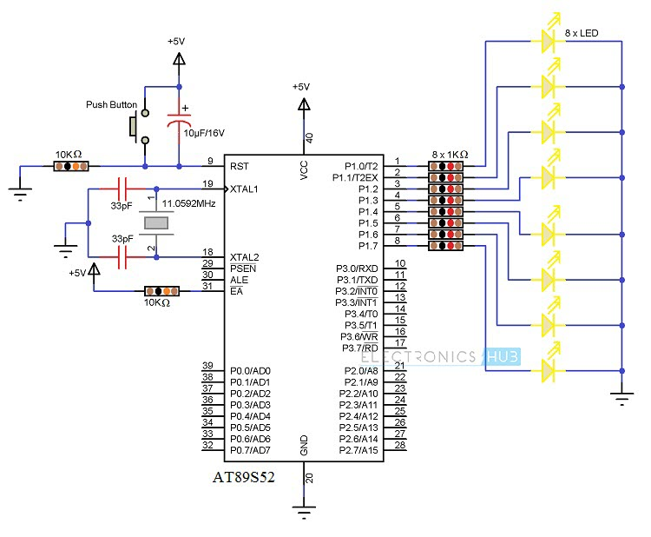

Slide 14
#include<reg51.h> // Preprocessor Directive
void delay (int); // Delay Function Declaration
void main(void) // Main Function
{
P1 = 0x00;
/* Making PORT1 pins LOW. All the LEDs are OFF.
(P1 is PORT1, as defined in reg51.h) */
while(1) // infinite loop
{
P1 = 0xFF; // Making PORT1 Pins HIGH i.e. LEDs are ON.
delay(1000);
/* Calling Delay function with Function parameter as 1000.
This will cause a delay of 1000mS i.e. 1 second */
P1 = 0x00; // Making PORT1 Pins LOW i.e. LEDs are OFF.
delay(1000);
}
}
void delay (int d) // Delay Function Definition
{
unsigned int i=0; // Local Variable. Accessible only in this function.
/* This following step is responsible for causing delay of 1000mS (or as per the value entered while calling the delay function) */
for(;d>0;d–)
{
for(i=250;i>0;i – -);
for(i=248;i>0;i – -);
}
}

Slide 15
Loops and Infinite Loops
Looping instructions are used for executing a particular block of code repeatedly till a condition is met or wait till an event if fired.
Embedded programming often uses the looping instructions for checking the status of certain I/O ports, registers, etc. and also for producing delays.
Commonly used loop instructions are
While, do-while and for loop

Slide 16
Loops
For Loop: A for loop is a repetition control structure that allows you to efficiently write a loop that needs to execute a specific number of times.
Syntax
for ( initial; test; increment )
{ statements;
}
Example:
uint16_t total = 0;
uint16_t values[100]; ...
for ( i = 0; i < 100; i++)
{
total = total + values[i];
}

Slide 17
while loop
A while loop in C programming repeatedly executes a target statement as long as a given condition is true.
Syntax
The syntax of a while loop in C programming language is
while(condition)
{
statement(s);
}
Here, statement(s) may be a single statement or a block of statements.
The condition may be any expression, and true is any nonzero value.
The loop iterates while the condition is true.
When the condition becomes false, the program control passes to the line immediately following the loop.

Slide 18
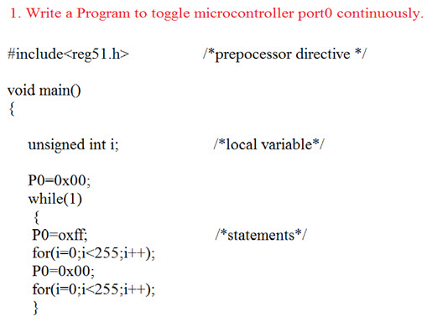

Slide 19
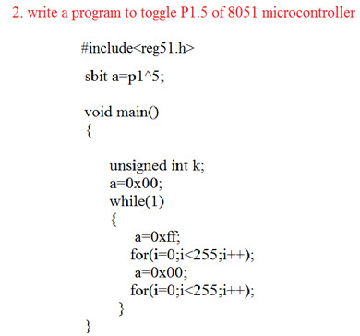

Slide 20
Pointers
A pointer is a variable whose value is the address of another variable, i.e., direct address of the memory location.
Any variable or constant, you must declare a pointer before using it to store any variable address.
The general form of a pointer variable declaration is
type *var-name;
int *ip; /* pointer to an integer */
double *dp; /* pointer to a double */
float *fp; /* pointer to a float */
char *ch /* pointer to a character */

Slide 21
Structures
Structures allow us to define application-dependent data objects that can associate individual variables of different types with one another.
This leads to an efficient means of manipulating the data.
Specialized structures, called data structures, can be used for various applications such as messaging between two embedded systems and storing data gathered from a sensor in noncontiguous memory locations.
Structures are useful when we need to access the registers of a memory-mapped microcontroller peripheral.
We may be able to make memory usage more efficient by rearranging the order of the members within a structure.

Slide 22
A number of variables of the same type that are logically related to one another can be grouped as an array.
Working on a group rather than a collection of independent variables allows us to arrange the data and use it more conveniently.
For example, we may define the following array to store the last 50 samples of an ADC that digitizes a voice input:
uint16_t voice[50];
Arrays can be used to group a number of variables that are of the same data type.
Establishing connection between variables of different data types? Can we treat these variables as a group in our program? For example, assume that we need to specify the sampling rate of the ADC that generates the voice array .
We can define a float variable to store the sample rate:
float sample_rate;

Slide 23
Although the variables voice and sample_rate are related to each other, they are defined as two independent variables.
To associate these two variables with each other, we can use a powerful data construct of the C language called a structure.
Structures allow us to group different data types and deal with them as a single data object.
Structures allow us to define application-dependent data objects that can associate individual variables of different types with one another.
This leads to an efficient means of manipulating the data.
Structures are useful when we need to access the registers of a memory-mapped microcontroller peripheral.

Slide 24
A structure can include different sorts of variable types such as other structures, pointers to functions, pointers to structures, etc.
For the voice example, we can use the following structure:
struct record
{
uint16_t voice[50];
float sample_rate;
};
Data structures can be used for various applications such as messaging between two embedded systems and storing data gathered from a sensor in noncontiguous memory locations.

Slide 25
Declaring a Structure
It’s worthwhile to mention that there is no memory allocation for storing a structure template.
Memory allocation occurs only after a structure variable based on this layout is defined.
The following code declares the variable mic1 of the above template:
struct record mic1;
Now, a section of memory is allocated for the variable mic1.
It has space to store the uint16_t elements of the array and one float variable.

Slide 26
Functions
Function is a group of statements that together perform a task.
A function is a self contained and reusable code snippet intended to perform a particular task.
Embedded C supports two different types of functions:
Library functions and user defined functions
Library functions are built-in functions which are ether part of standard ‘Embedded C’ library or user created library files.
Library files are categorised into various types like I/O functions, string operation functions, memory allocation functions etc.
Eg: printf(), strcpy(), malloc()

Slide 27
Function
Every C program has at least one function, which is main(), and all the most trivial programs can define additional functions.
A function declaration tells the compiler about a function's name, return type, and parameters.
A function definition provides the actual body of the function.
The C standard library provides numerous built-in functions that your program can call. For example, strcat() to concatenate two strings, memcpy() to copy one memory location to another location, and many more functions.
A function can also be referred as a method or a sub-routine or a procedure, etc.

Slide 28
Defining a Function
The general form of a function definition in C programming language is as follows
return_type function_name( parameter list )
{
body of the function
}
Example
/* function returning the max between two numbers */
int max(int num1, int num2) {
/* local variable declaration */
int result;
if (num1 > num2) result = num1;
else result = num2; return result;
}

Slide 29
Macros
A macro is a collection of codes that is defined in a program by a name.
It differs from a function in the sense that once a macro is defined by a name, the compiler puts the corresponding codes for it at every place where that macro name appears.
Functions are used when the requirement is that the codes should be compiled once only.
However, on calling a function, the processor has to save the context, and on return, restore the context.
Further, a function may return nothing (void declaration case) or return a Boolean value, or an integer or any primitive or reference type of data
Macros are generally used to define constant values that are being used repeatedly in program.
Macros can even accept arguments and such macros are known as function-like macros.
The ‘#define’ pre-processor directive is used for coding macros.

Slide 30
Example:
#include<stdio.h>
#define MAX_SIZE 10
int main(void)
{
int size = 0; size = size + MAX_SIZE;
printf("\n The value of size is [%d]\n",size);
}
Advantages:
Macros are used for short operations and it avoids function call overhead.
It can be used if any short operation is being done in program repeatedly.
Function-like macros are very beneficial when the same block of code needs to be executed multiple times.

Slide 31
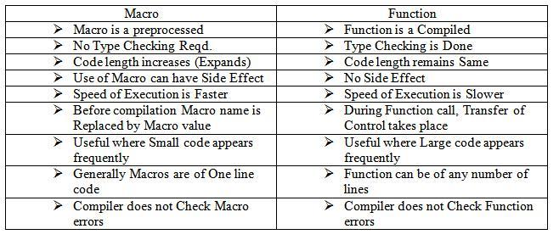
Macro and Function

Slide 32
Objected Oriented Programming
An objected oriented language is used when there is a need for re-usability of the defined object or set of objects that are common within a program or between the many applications.
When a large program is to be made, an object-oriented language offers many advantages. Data encapsulation, design of reusable software components and inheritance are the advantages derived from the OOPs.
An object-oriented language provides for defining the objects and methods that manipulate the objects without modifying their definitions.
It provides for the data and methods for encapsulation.

Slide 33
Embedded C++
C++ is an object oriented Program (OOP) language, in addition, supports the procedure oriented codes of C.
Program coding in C++ codes provides the advantage of objected oriented programming as well as the advantage of C and in-line assembly.
Programming concepts for embedded programming in C++ are as follows:
A class can derive (inherit) from another class also.
Methods (C functions) can have same name in the inherited class.
Methods can have the same name as well as the same number and type of arguments in the inherited class.
The struct binds all the member functions together in C. But a C++ class has object features. It can be extended and child classes can be derived from it.
A number of child classes can be derived from a common class.

Slide 34
Disadvantages of C++
Program codes become lengthy, particularly when certain features of the standard C++ are used.
Examples of these features are as follows:
(a) Template.
(b) Multiple Inheritance (Deriving a class from many parents).
(c) Exceptional handling.
(d) Virtual base classes.
(e) Classes for IO Streams.

Slide 35
EMBEDDED PROGRAMMING IN JAVA
Java is an object-oriented language similar to C++.
Java has a number of advantages for embedded system designers.
Java simplifies inheritance by eliminating multiple inheritance and replacing it with interfaces.
Java prevents the ambiguity that C++ allows in the definition of operators.

Slide 36
EMBEDDED PROGRAMMING IN JAVA
Java has advantages for embedded programming as follows:
1.Java is completely an OOP language.
2.Java has in-built support for creating multiple threads.
3.Java is the language for most Web applications and allows machines of different types to communicate on the Web.
4.There is a huge class library on the network that makes program development quick.
5.Platform independence in hosting the compiled codes on the network is because Java generates the byte codes. Platform independence gives portability with respect to the processor used.
6.Java does not permit pointer manipulation instructions. So it is robust in the sense that memory leaks and memory related errors do not occur.
7.Java being platform independent is expected to run on a machine with an RISC like instruction execution with few addressing modes only.

Slide 37
Disadvantages of Java
Java byte codes that are generated need a larger memory when a method has more than 3 or 4 local variables.
An embedded Java system may need a minimum of 512 kB ROM and 512 kB RAM because of the need to first install JVM and run the application.
As Java codes are first interpreted by the JVM, it runs comparatively slowly.
To overcome this disadvantage, Java bytes codes can be converted to native machine codes for fast running using just-in-time (JIT) compilation.
A Java accelerator can be used in the system for fast code-run.

